Slide 1
Machine Learning Based Customer Churn Prediction in Banking
Sara Samaninia
St No: 501090785
Supervisor: Dr. Tamer Abdou

Slide 2
Customer churn definition and the Importance
Customer churn (also known as customer attrition) occurs when a customer stops using a company's products or services.
Customer churn affects profitability*. Therefore, customer churn analysis is essential as it can help a business.
Notes:
*It is estimated that acquiring a new customer can cost up to five times more than retaining an existing one.

Slide 3
How Customer Churn Prediction can help a business
Identify the customers who are currently at churn risk and Customer Relationship Management can apply some strategies to gain back their trust
The list can also help designing the marketing and sales campaigns’ target groups
Identify problems and the features that contribute the most in customer churn
Make correct strategic decisions that would lead to higher customer satisfaction and consequently higher customer retention.

Slide 4
The goal of this notebook is to understand and predict customer churn for a bank
This problem is a typical classification task.
For comparing and optimising the machine learning models, I used recall since correctly classifying elements of the positive class (customers who will churn) is more critical for the bank
Techniques used: Exploratory Data Analysis, Data Visualisation, Data Preprocessing (Feature Selection, Encoding Categorical Features, Feature Scaling), Addressing Class Imbalance (SMOTE), Model Tuning.
Models used: Logistic Regression, Support Vector Machines, KNN, Decision tree, Random Forests, Gradient Boosting, XGBoost, and Light Gradient Boosting Machine and CatBoost

Slide 5
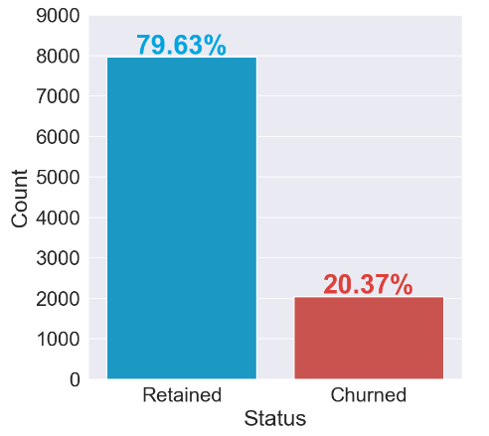
EDA Analysis
Exploratory Data Analysis (EDA) helped to understand the dataset better and identify and visualise the factors contributing to customer churn.
Our DataFrame has 14 features/attributes and 10K customers. And no missing values in our DataFrame.
The last feature, 'Exited', is the target variable
(0) for a customer that has not churned
(1) for a customer that has churned.

Slide 6
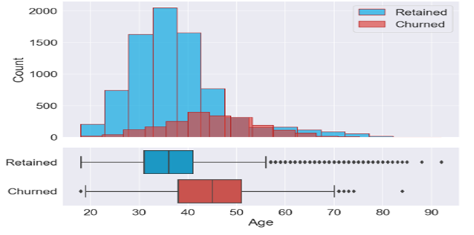
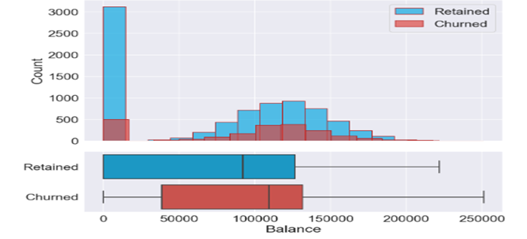
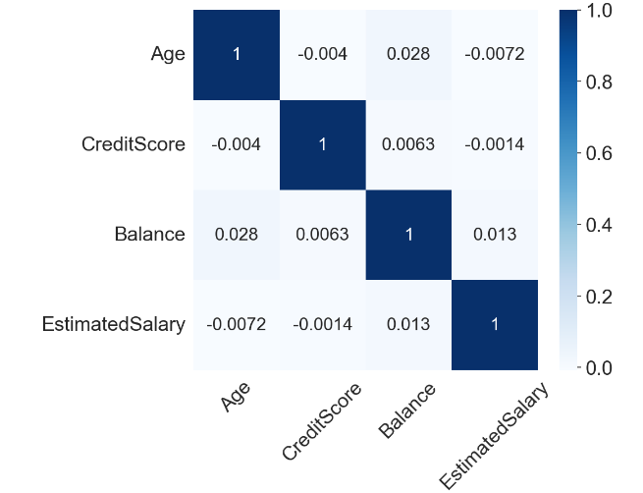
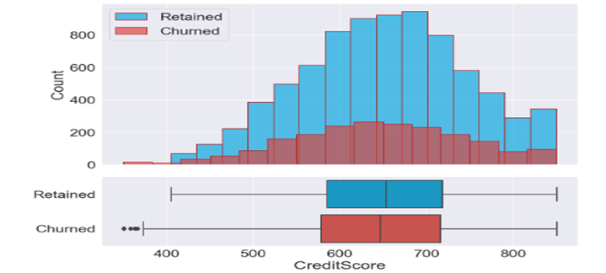
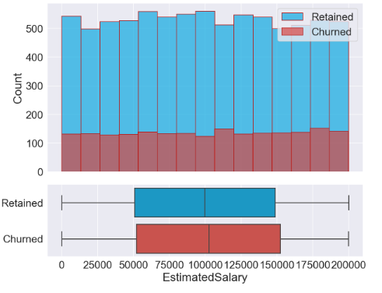
Continuous Variables

Slide 7
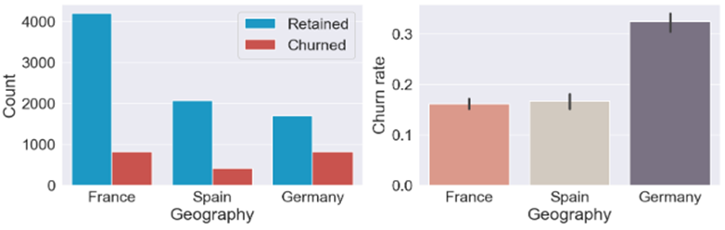
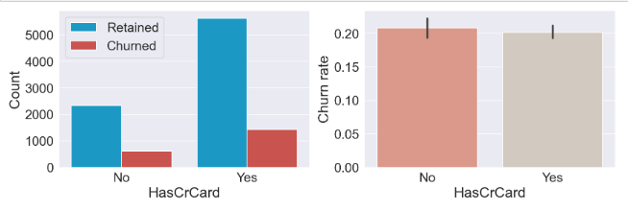
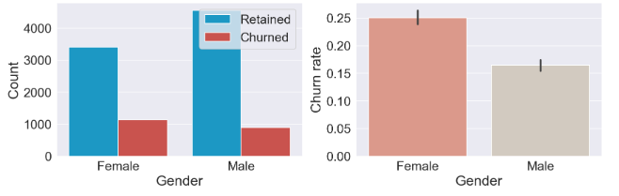
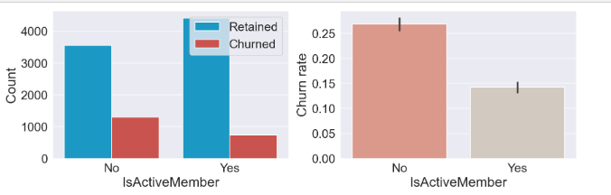
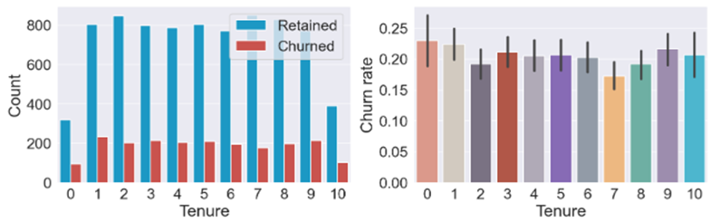
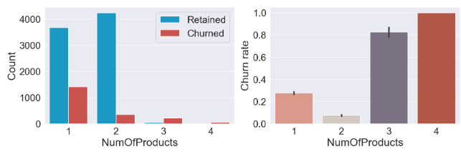
Categorical Variables

Slide 8
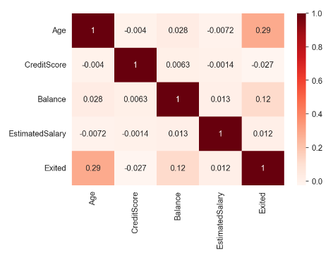
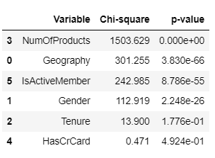
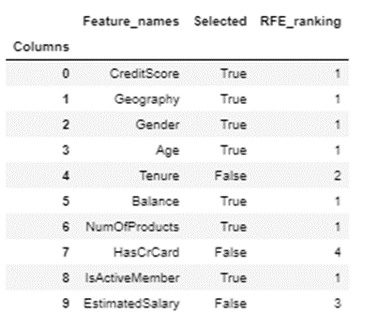
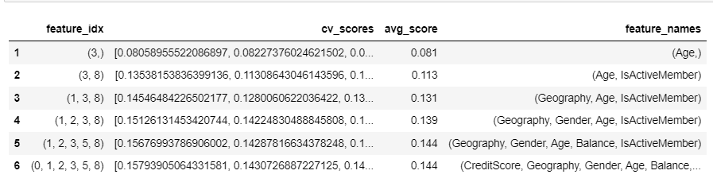
Data Preprocessing
Encoding Categorical Features
Scaling (Normalising)
Feature Selection
Chi-square test , Correlation
Forward, Backward selection

Slide 9
Data Preprocessing
Splitting our dataset into train and test
Train set: 8000 rows
Test set: 2000 rows
y_train.value_counts()
0 6356
1 1644
Addressing Class Imbalance
By
SMOTE ('Synthetic Minority Oversampling Technique’)
(SMOTE Oversampling)
0 6356
1 6356

Slide 10
Evaluation: Effectiveness

Slide 11
Evaluation: Stability & Efficiency
Model | Efficiency (Time)
LR | 0,04
KNN | 0,30
DT | 0,08
RF | 1,79
SVM | 5,29
GBC | 1,69
XGB | 1,03
LightGBM | 0,18
CatBoost | 7,46

Slide 12
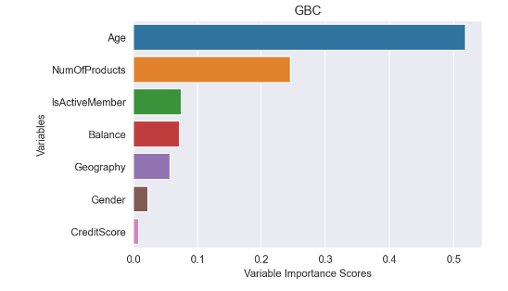
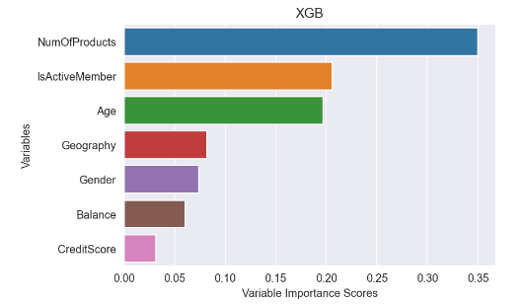
Feature Importance in models

Slide 13
The best models are GBC and SVM based on the recall score (77% and 75%), however GBC is a more efficient model. Most of the models have very high accuracy and AUC scores (Higher than 80%). The results reveal that the most significant features are age, number of products and IsActiveMember. The bank should take some measures to customize the service or products for the older customers as well as customers with more products. It is also beneficial to apply some methods to keep the customers engaged. It probably will increase the satisfaction for those targeted customers who are more likely to churn. Adding more features and records also can improve the power or prediction. So gradually if the bank gathers more data with expanded features, it can improve the predictive performance.
Conclusion

Slide 14
Thank You

